Slide 1
Topic 10: Text Compression: Huffman Encoding
COMP2014J: Data Structures and Algorithms 2
Dr. David Lillis (david.lillis@ucd.ie)
Beijing-Dublin International College

Slide 2
Text Compression
Characters are usually encoded in some way, with each character mapped to some binary code.
ASCII (or extended ASCII): 7 or 8 bits per character
UTF-8: variable-length code:
Minimum 8 bits per character (For the Latin alphabet, the codes are the same as ASCII).
Up to 32 bits per character.
Compression: given a string X, efficiently encode X into a smaller string Y.
Saves memory and/or bandwidth.

Slide 3
Text Compression
A good approach: Huffman encoding
Uses a variable-length binary “code word” to represent each character.
Compute frequency f(c) for each character c.
Encode high-frequency characters with short code words.
No code word is a prefix for another code.
i.e. no code word begins with the same code as another character.
Use an optimal encoding tree to determine the code words.

Slide 4
Encoding Tree Example
A code is a mapping of each character of an alphabet to a binary code-word.
A prefix code is a binary code such that no code-word is the prefix of another code-word.
An encoding tree represents a prefix code
Each external node stores a character.
The code word of a character is given by the path from the root to the external node storing the character (0 for a left child and 1 for a right child).
00 | 010 | 011 | 10 | 11
a | b | c | d | e
a
d
e
b
c

Slide 5
Encoding Tree Optimization
Given a text string X, we want to find a prefix code for the characters of X that causes a small encoding for X
Frequent characters should have short code-words.
Rare characters should have long code-words.
Example
X = abracadabra
T₁ encodes X into 29 bits
T₂ encodes X into 24 bits
T₁
T₂
c
d
b
a
b
r
a
r
c
d

Slide 6
Huffman’s Algorithm
Algorithm HuffmanEncoding(X)
Input string X of size n
Output optimal encoding tree for X
C ← distinctCharacters(X)
computeFrequencies(C, X)
Q ← new empty heap
for all c ⇓C
T ← new single-node tree storing c
Q.insert(getFrequency(c), T)
while Q.size() > 1
f₁ ← Q.minKey()
T₁ ← Q.removeMin()
f₂ ← Q.minKey()
T₂ ← Q.removeMin()
T ← join(T₁, T₂)
Q.insert(f₁ + f₂, T)
return Q.removeMin()
Given a string X, Huffman’s algorithm constructs a prefix code that minimizes the size of the encoding of X.
It runs in time O(n + d log d), where n is the size of X and d is the number of distinct characters of X.
A heap-based priority queue is used as an helper data structure.

Slide 7
Huffman’s Algorithm
Count the frequency of every distinct character in X
Create a new binary tree for each character and add to the queue (with its frequency as the priority)
Algorithm HuffmanEncoding(X)
Input string X of size n
Output optimal encoding tree for X
C ← distinctCharacters(X)
computeFrequencies(C, X)
Q ← new empty heap
for all c ⇓C
T ← new single-node tree storing c
Q.insert(getFrequency(c), T)
while Q.size() > 1
f₁ ← Q.minKey()
T₁ ← Q.removeMin()
f₂ ← Q.minKey()
T₂ ← Q.removeMin()
T ← join(T₁, T₂)
Q.insert(f₁ + f₂, T)
return Q.removeMin()
Continue until there is only 1 tree left in the queue.
On each iteration, remove the two trees with highest priority (lowest frequency) from the queue and join them together.
Then re-insert into the queue with the sum of their frequencies as the new priority.

Slide 8
Example
11
X = abracadabra
a
6
Frequencies
2
4
a | b | c | d | r
5 | 2 | 1 | 1 | 2
c
d
b
r
6
2
4
a
b
c
d
r
5
2
1
1
2
a
c
d
b
r
5
2
2
4
a
b
c
d
r
a
c
d
b
r
5
2
2
5

Slide 9
Encoding a String
11
a
6
Using this Huffman Tree, the encoding for “abracadabra” would be:
a b r a c a d a b r a
0 110 111 0 100 0 101 0 110 111 0
Remember, UTF-8 uses at least 8 bits per character:
Minimum UTF-8 bit length = length(string) x 8 = 11 x 8 = 88
However, when saving in a file, we must encode the Huffman tree also, which will reduce the space savings.
2
4
c
d
b
r

Slide 10
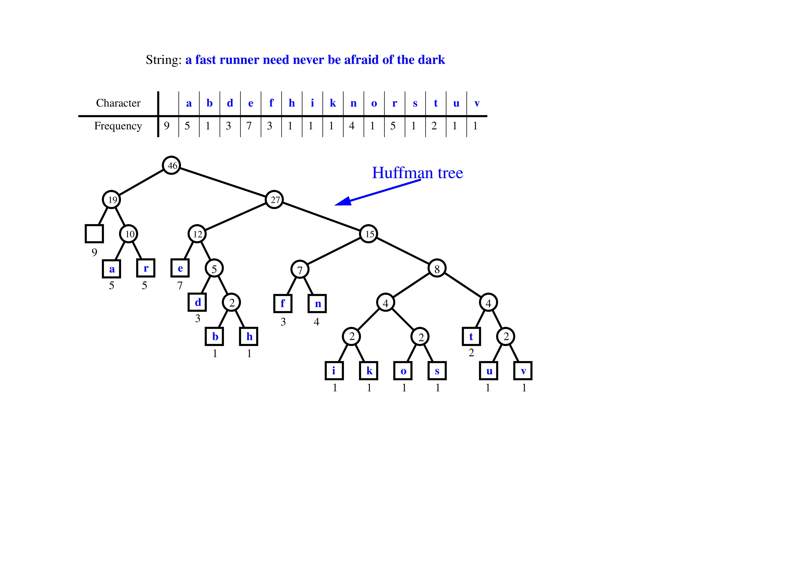
Extended Huffman Tree Example

Slide 11
Extended Huffman Tree Example
Notes:
Decode this: 10110 100 111011 11110 00 100 111111 100 011 (”best ever”)

